Slide 1
Cash and Financial Assets - Accounting Principles
2022. 4.
Dr. Yangin Yoon

Slide 2
Recap the last class
When the company acquires financial assets,
(recognition journal entry)
When it sells all the financial assets:
→ How to report in the end of each accounting period?
(If the company holds the Financial assets more than one year)
Historical value (cost) or market value?
Financial assets XXX
Cash XXX
Cash YYY
Financial assets XXX
Gains on disposal of FA YYY - XXX

Slide 3
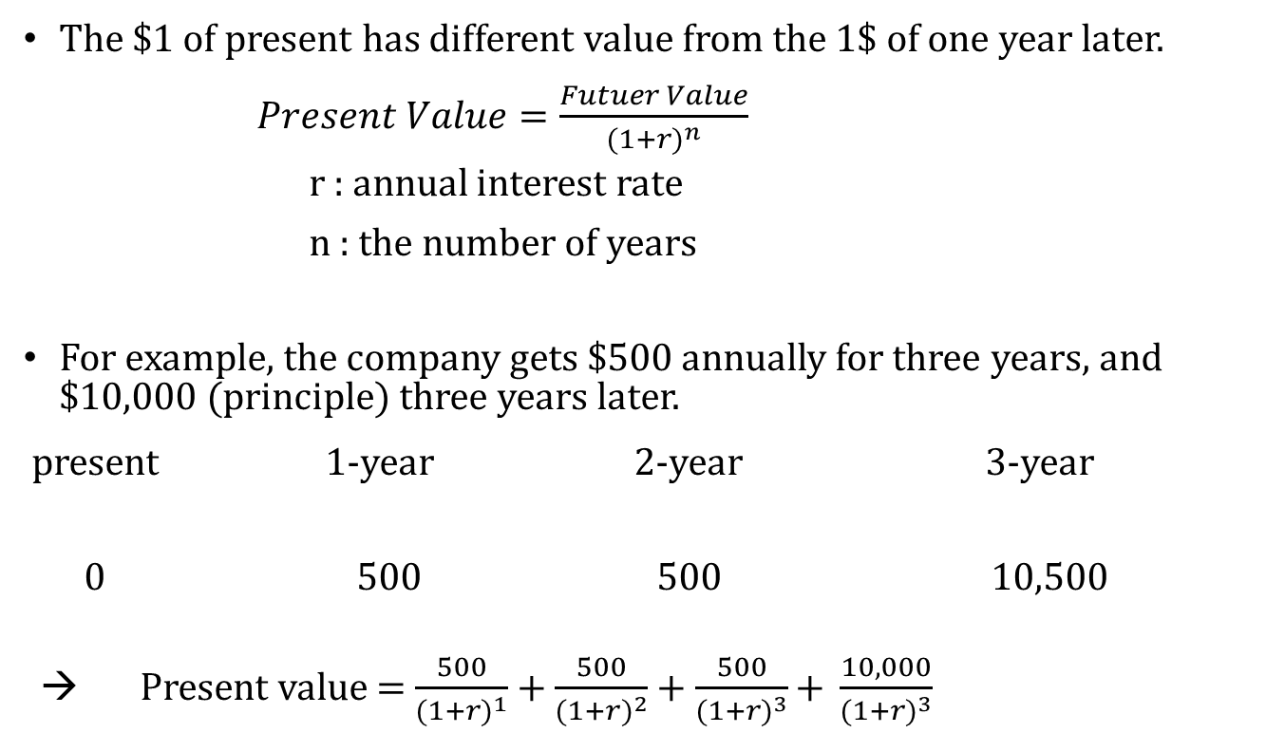
Recap the last class
The $1 of present has different value from the 1$ of one year later.
$Present Value=\frac{Futuer Value}{{(1+r)}^{n}}$
r : annual interest rate
n : the number of years
For example, the company gets $500 annually for three years, and $10,000 (principle) three years later.
present 1-year 2-year 3-year
0 500 500 10,500
→ Present value = $\frac{500}{{(1+r)}^{1}}$ + $\frac{500}{{(1+r)}^{2}}$ + $\frac{500}{{(1+r)}^{3}}\text{+ }\frac{10,000}{{(1+r)}^{3}}$

Slide 4

Recap the last class
For example, the company gets $500 annually for three years, and $10,000 (principle) three years later.
- The current annual interest rate is 6%. What is the fair value of this cash flow?
→ Present value = $\frac{500}{{(1+0.06)}^{1}}$ + $\frac{500}{{(1+0.06)}^{2}}$ + $\frac{500}{{(1+0.06)}^{3}}$ + $\frac{10,000}{{(1+0.06)}^{3}}$= 9,733
 | 2022.1.1. | 2022.12. | 2023.12 | 2024.12 | Sum of three years
Nominal amount | 0 | 500 | 500 | 10,500 | 11,500
Interest rate | 0.06
Discount factor | 1 | 0.943 | 0.890 | 0.840
Present Value | 0 | 472 | 445 | 8,816 | 9,733

Slide 5
Recap the last class
2022.1.1.
2022.12.31.
9,733*0.06 = 584
2023.12.31.
9,817*0.06 = 589
 | Interest Income | Value before the interest payment (A) | Small payback (B) | Value after payment (C=A-B)
2022.1.1. | - | 9,733 |  | 9,733
2022.12.31. | 584 (=9,773 * 6%) | 10,317 (=9733*1.06) | 500 | 9,817
2023.12.31. | 589 (=9,817 * 6%) | 10,406 (=9817*1.06) | 500 | 9,906
2024.12.31. | 594 (=9,906 * 6%) | 10,500 (=9906*1.06) | 500 | 10,000
Financial Assets 9,733
Cash 9,733
Financial Assets 84
Cash 500
Interest income 584
Financial Assets 89
Cash 500
Interest income 589

Slide 6
Recap the last class
2024.12.31.
9,906*0.06 = 594
 | Interest Income | Value before the interest payment (A) | Small payback (B) | Value after payment (C=A-B)
2022.1.1. | - | 9,733 |  | 9,733
2022.12.31. | 584 (=9,773 * 6%) | 10,317 (=9733*1.06) | 500 | 9,817
2023.12.31. | 589 (=9,817 * 6%) | 10,406 (=9817*1.06) | 500 | 9,906
2024.12.31. | 594 (=9,906 * 6%) | 10,500 (=9906*1.06) | 500 | 10,000
Financial Assets 94
Cash 500
Interest income 594
Cash 10,000
Financial Assets 10,000

Slide 7
Any Questions?

Slide 8
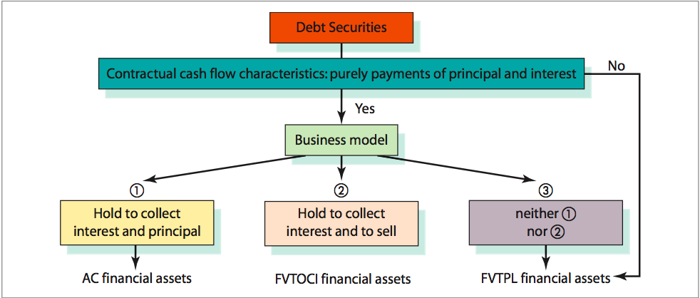
Financial Assets – Debt type assets
Classifications of Debt Securities

Slide 9
Financial Assets – Debt type assets
There are three types of accounting methods for debt type financial assets.
1) Amortized Cost (AC) Financial Assets
- Debt Securities for which the investors holds primarily to collect the interest and principal are measured at amortized cost
2) Fair Value Through Other Comprehensive Income (FVTOCI) Financial Assets
- Debt Securities that are held to collect interest and to sell before maturity are measured as fair value
3) Fair Value through Profit or Loss (FVTPL) Financial Assets
- Holding for selling in near future, and other cases

Slide 10
Financial Assets – Equity Type
Equity Investment
Equity
More than 20%?
Yes
No
Yes
Trading purpose?
Decide to use FVTOCI?
No
Yes
Fair Value through Profit or Loss (FVTPL)
Fair Value Through Other Comprehensive Income (FVTOCI)
Equity Method

Slide 11
Financial Assets – Equity Type
Equity Investment
1) Fair Value Through Other Comprehensive Income (FVTOCI) Financial Assets
- Equity Securities for which the investor holds not for the trading purpose. In addition, the company choose to classify this as FVTOCI
2) Fair Value through Profit or Loss (FVTPL) Financial Assets
- Equity Securities that are held for the trading purpose
3) Investments in Associates (Using the Equity Method)
- When an investor has significant influence but not control over an investee, the investee is an associate
- Significant influence is presumed with a shareholding of between 20% and 50% of the voting rights.

Slide 12
Fair Value through Profit or Loss (FVTPL)
Fair Value through Profit or Loss (FVTPL)
1) Re-evaluating at every period
- If the price is increased, the net-income increases.
- If the price decreases, the net-income decreases.
2) Example
We bought two stocks on 20x0.1.7., and we hold it until 20x2.12.31.
Stock Price of Company ABC (USD/stock)
20x0.1.7. | 20x0.12.31. | 20x1.12.31 | 20x2.12.31.
$400 | $450 | $510 | $350
20x0.1.7.
FVTPL (Financial assets) $800
Cash (assets) $800
20x0.12.31.
FVTPL (assets) $100
Gain on valuation of FVTPL (gain) $100
20x1.12.31.
FVTPL (assets) $120
Gain on valuation of FVTPL $120
20x2.12.31.
Loss on valuation of FVTPL (gain) $320
FVTPL $320

Slide 13
Fair Value Through Other Comprehensive Income (FVTOCI)
Fair Value through Profit or Loss (FVTOCI)
1) Re-evaluating at every period.
- If the price is increased, there is no change in net-income.
- If the price is increased, the total equity increases.
2) Example
We bought two stocks on 20x0.1.7., and the company to choose to use FVTOCI.
Stock Price of Company ABC (USD/stock)
20x0.1.7. | 20x0.12.31. | 20x1.12.31 | 20x2.12.31.
$400 | $450 | $510 | $350
20x0.1.7.
FVTOCI (Financial assets) $800
Cash $800
20x0.12.31.
FVTOCI $100
Unrealized Gains of FVTOCI (equity) $100
20x1.12.31.
FVTOCI $120
Unrealized Gains of FVTOCI (equity) $120

Slide 14
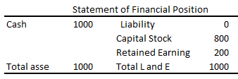
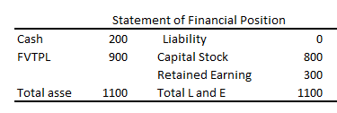

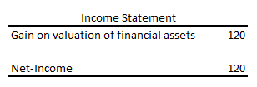
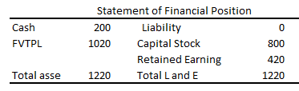
FVTPL vs. FVTOCI
The asset sides and total equity are the same.
- The net-incomes are different.
20x0.1.1.
Stock Price of Company ABC (USD/stock)
20x0.1.7. | 20x0.12.31. | 20x1.12.31 | 20x2.12.31.
$400 | $450 | $510 | $350
20x0.12.31. FVTPL
20x1.12.31. FVTPL

Slide 15
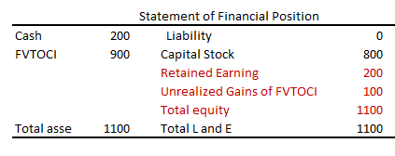

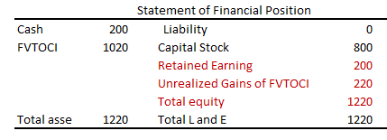
FVTPL vs. FVTOCI
The asset sides and total equity are the same.
- The net-incomes are different.
20x0.1.1.
Stock Price of Company ABC (USD/stock)
20x0.1.7. | 20x0.12.31. | 20x1.12.31 | 20x2.12.31.
$400 | $450 | $510 | $350
20x0.12.31. FVTOCI
20x1.12.31. FVTOCI

Slide 16
FVTOCI – Debt Type Financial Assets
2022.1.1.
2022.12.31.
9,733*0.06 = 584
If the value of this bond is 9,900 on 2022.12.31, what is a journal entry for this FVTOCI financial asset.
 | Interest Income | Value before the interest payment (A) | Small payback (B) | Value after payment (C=A-B)
2022.1.1. | - | 9,733 |  | 9,733
2022.12.31. | 584 (=9,773 * 6%) | 10,317 (=9733*1.06) | 500 | 9,817
2023.12.31. | 589 (=9,817 * 6%) | 10,406 (=9817*1.06) | 500 | 9,906
2024.12.31. | 594 (=9,906 * 6%) | 10,500 (=9906*1.06) | 500 | 10,000
FVTOCI (asset) 9,733
Cash 9,733
FVTOCI (asset) 84
Cash (asset) 500
Interest income (gain) 584
2022.12.31.
FVTOCI (asset) 83
Unrealized Gains of FVTOCI (equity) 83
What is the book value of FVTOCI on 2022.12.31.?

Slide 17
Equity Method – Equity Type Financial Asset
Equity Method
1) When you acquire more than 20% of shares, you need to use equity method.
- Gain from the shares is calculated by using the net-income and the ratio of your ownership.
2) Example
- Your company bought the 25% of ABC company’s total stocks on 2020.2.7. (paying $10,000 of cash), and the net-income of ABC in the year 2020 is $2,000.
2020.2.7.
Equity method stock (assets) $10,000
Cash $10,000
2020.12.31.
Equity method stock (assets) $500
Gain on equity method stock (gain) $500
$2,000 * 25% = 500
2021.3.20. The ABC company give us $ 350 dividend as cash
2021.3.20.
Cash $350
Equity method stock (assets) $350

Slide 18
Any Questions?

Slide 19
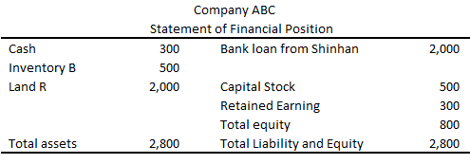
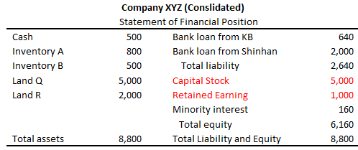
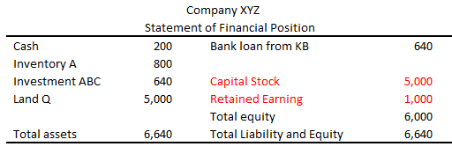
Consolidated Financial Statements
This topic is advance accounting.
- We need consolidated financial statements when one company owns another company.
- For example, XYZ Company owns 80% of ABC Company.
20x0.12.31.
20x0.12.31.
20x0.12.31.

Slide 20
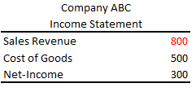
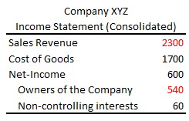
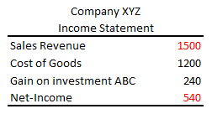
Consolidated Financial Statements
This topic is advance accounting.
- We need consolidated financial statements when one company owns another company.
- For example, XYZ Company owns 80% of ABC Company.
20x1.1.1. ~ 20x1.12.31.
20x1.1.1. ~ 20x1.12.31.
20x1.1.1. ~ 20x1.12.31.

Slide 21
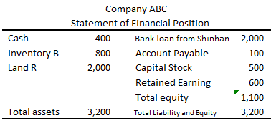
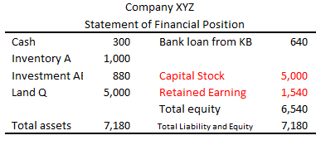
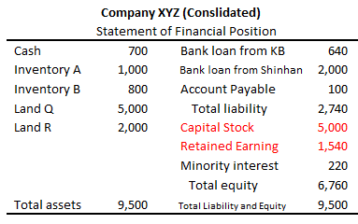
Consolidated Financial Statements
20x0.12.31.
20x1.1.1. ~ 20x1.12.31.
20x1.12.31.

Slide 22
Any Questions?

